Slide 1
The Genetics of Schizophrenia
The contribution of Common Variants
and Genes Implicated in a Maternal Immune activation Model
CHOI Shing Wan
PhD Candidate
2008558601

Slide 2
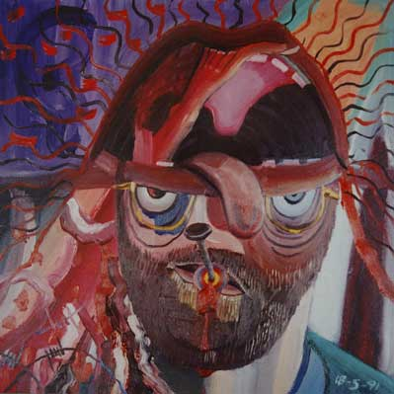
Schizophrenia
A serious mental disorder
Delusions, hallucinations, thought disorder, cognitive deficits
Population prevalence of ~1%
Heritability ~80%
From family and twin studies
Drawing by Bryan Charnley

Slide 3
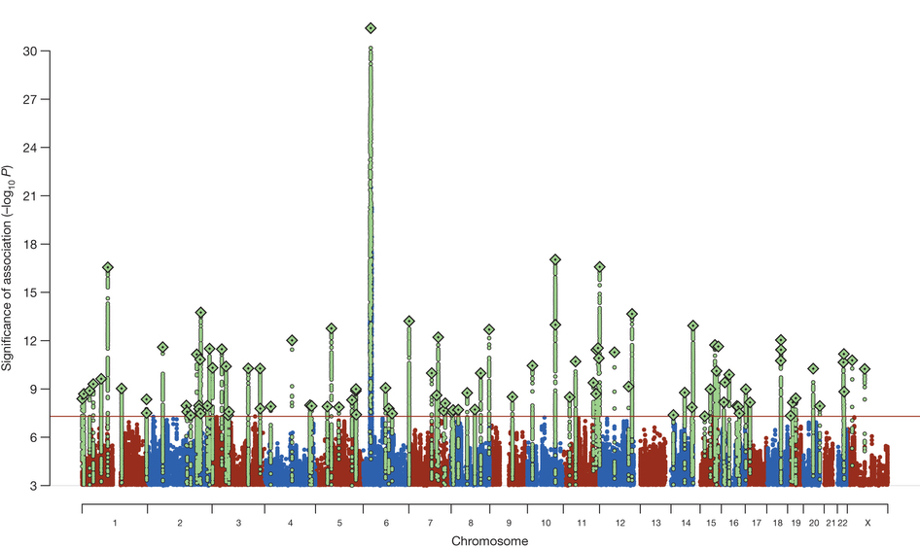
Polygenic Etiology of Schizophrenia
Psychiatric Genomics Consortium
Contain 36,989 cases and 113,075 controls
Genome Wide Meta Analysis
Identified 108 associated genetic loci
Amount of Heritability explained by common variants?
Ripke et al (2014), Nature
Notes:
Finally identify some of the associated genetic loci
GWAS -> Focus on common variant
So how much heritability does these variant explained?
The challenge, however, is that the for one to study a complex disorder, large amount of samples are required.
This is often only achievable through collaboration and meta analysis.
In such scenarios, the raw genotypes might not be available due to privacy concerns.
Thus, one cannot estimate the SNP heritability using tools like GCTA.

Slide 4
Estimating SNP Heritability
GCTA
Utilizes the genetic relationship matrix (GRM)
Requires individual genotypes
LDSC
Assumes a polygenic model
Based on LD score
Elevation in test statistics is proportional to the LD of SNP with the causal variant
But not with confounding factors
Notes:
Use REML to estimate the sigma of genetics and environment

Slide 5
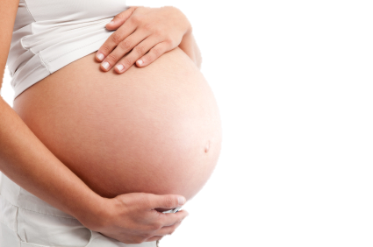
Maternal Immune Activation
Environmental Factors
Maternal Infection
Estimated to account for roughly 1/3 of cases
Animal model
PolyIC injection
Mechanism
Through changes in gene expression
Notes:
Because heritability of Schizophrenia is only 80%
The remaining 20% can be accounted by environmental factors
Of all environmental factors -> MIA

Slide 6
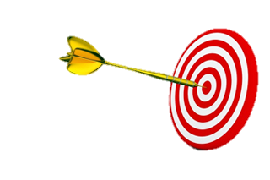
Aims
Part 1: Estimate the SNP heritability of Schizophrenia
Evaluate the performance of LDSC
Possible improvements? E.g. Oligo-genic traits?
Part2: Investigate effect of maternal immune activation (MIA) on gene expression level
Use RNA Sequencing
Cerebellum from MIA exposed mouse
In addition, investigate the effect of diet

Slide 7
SNP Heritability Estimation

Slide 8
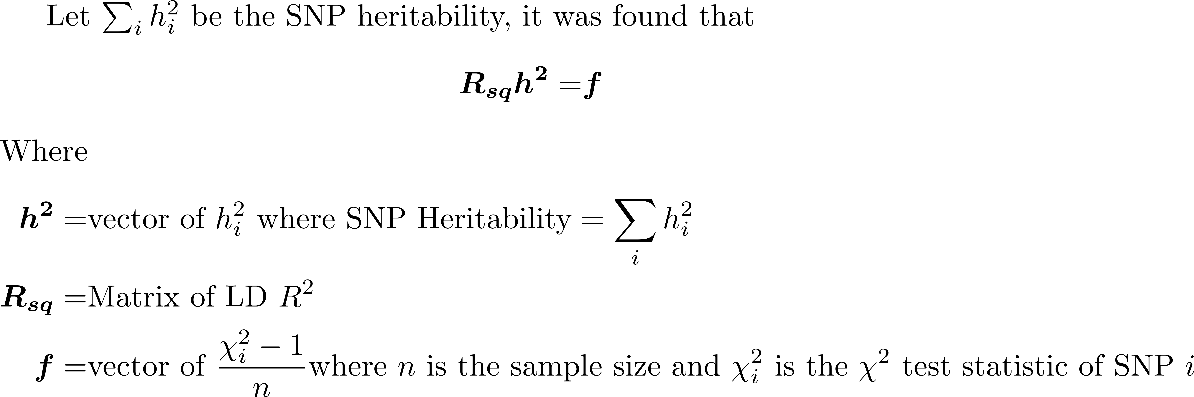
Alternative to LDSc

Slide 9
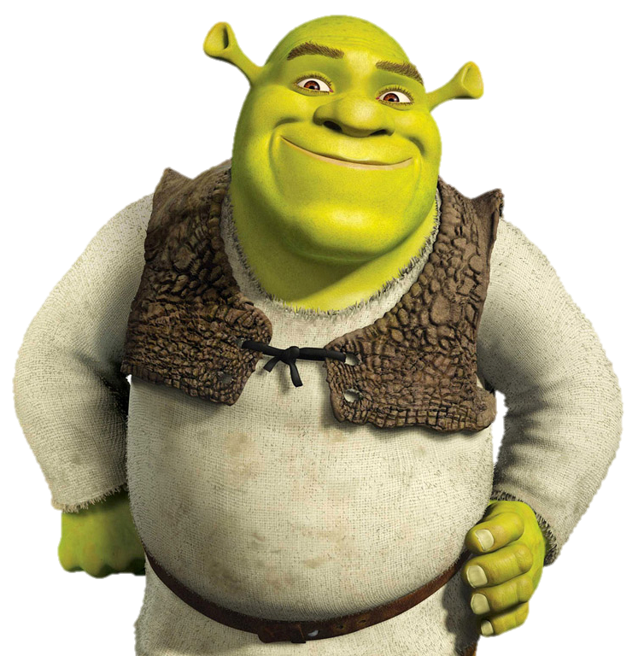
Methodology
Snp HeRitability Estimation Kit (SHREK )
https://github.com/choishingwan/shrek/
Notes:
To minimize this problem, we employed the truncated SVD where we remove small singular values from the matrix before the inversion. Therefore help us to generate a slightly more robust results.
However, the truncated SVD cannot completely solve the problem as it cannot help us to remove all collinear SNPs from the matrix. And this is basically the main flaw of our method.
To conclude, we have implemented the algorithm in Snp heritability estimation Kit (SHREK).

Slide 10
Methodology
Case-Control
Repeat 50 times
Randomly Select SNPs with MAF > 0.05
Simulate 1000/p samples
p ∈ {0.5,0.1,0.05,0.01}
Case-Control
Quantitative
Generate k effect Sizes
𝑘 ∈ {5, 10, 50, 100, 500}
Simulate Phenotypes
Heritability 0 - 0.9
Simulate
1,000 samples
5,000 SNPs
Chr22
50,000 SNPs
Chr1
Quantitative
GCTA
LDSC with fixed intercept
LDSC with intercept estimation
SHREK
Simulate 500 reference Samples
Repeat 10 times

Slide 11
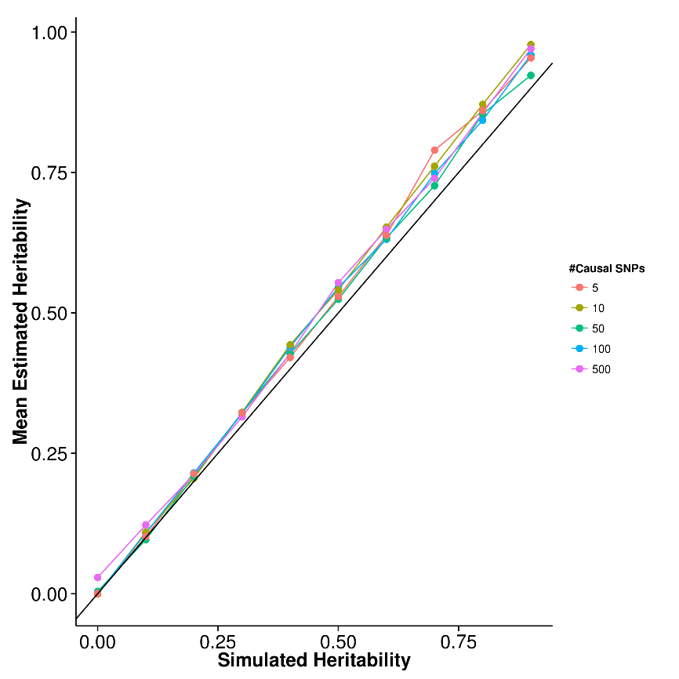
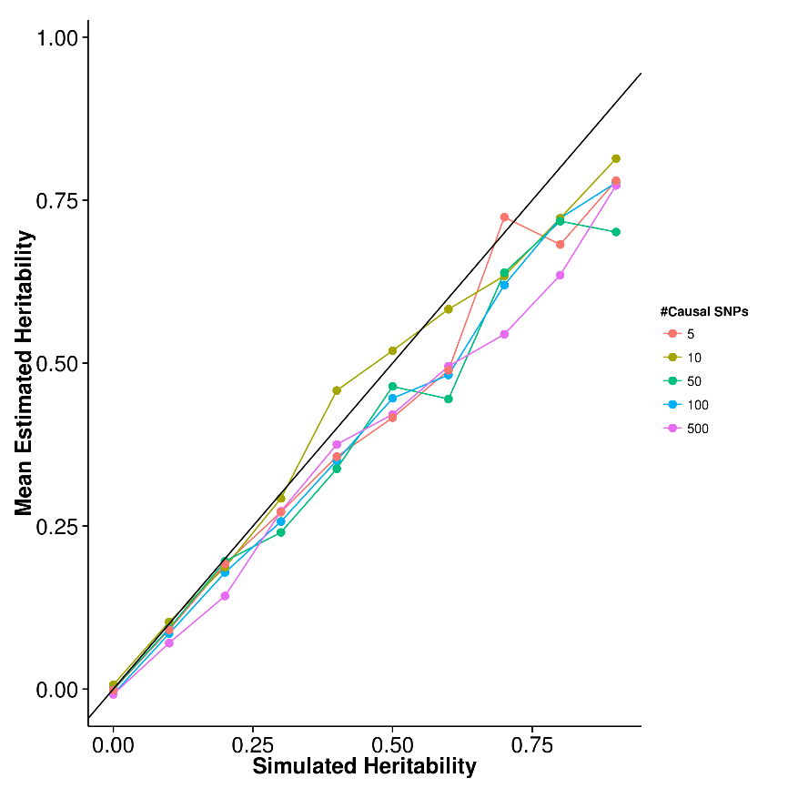
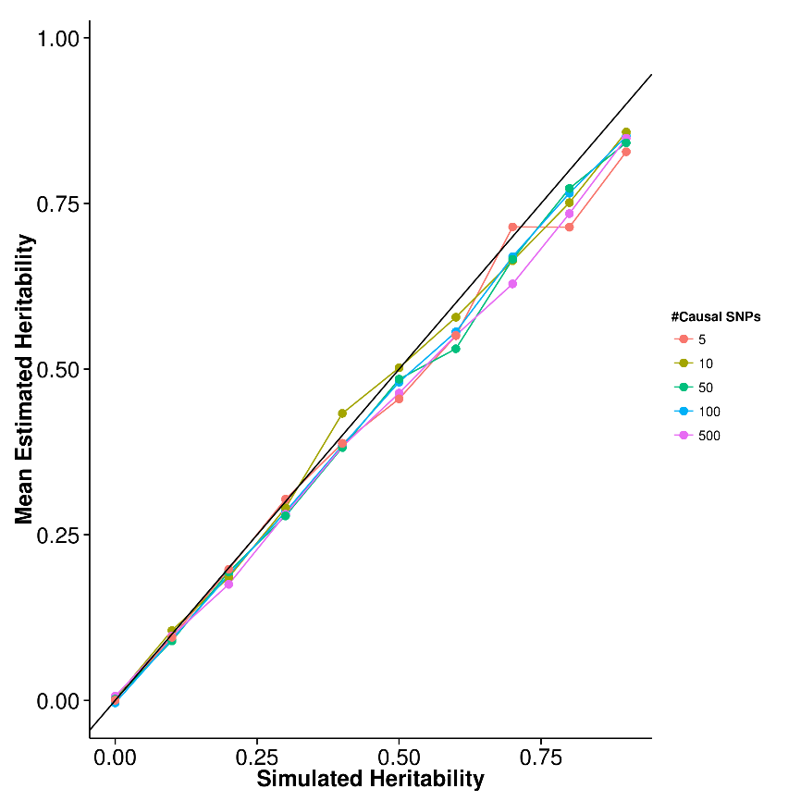
Results (Quantitative Trait)
SHREK
LDSC
GCTA
Upward bias observed in SHREK
Small downward bias observed in LDSC and GCTA

Slide 12
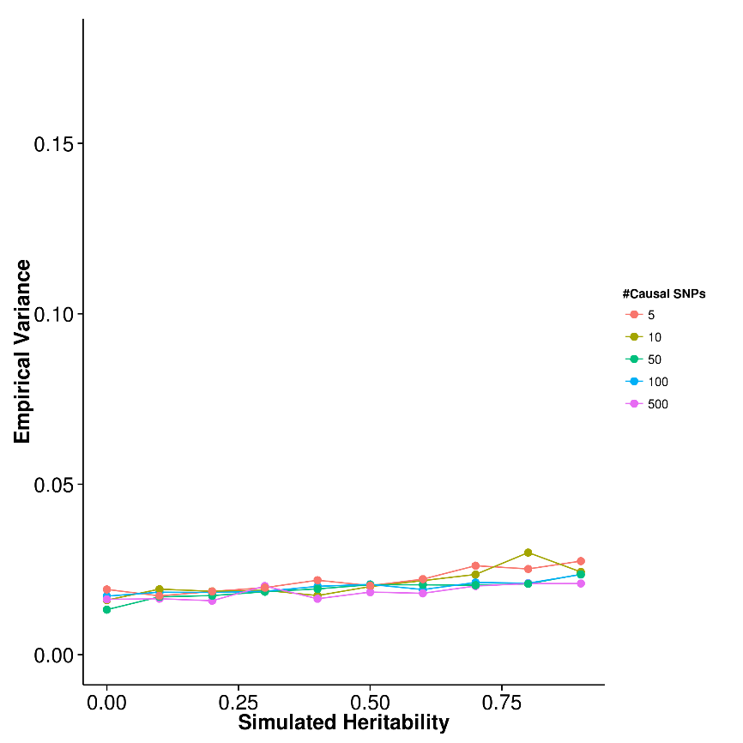
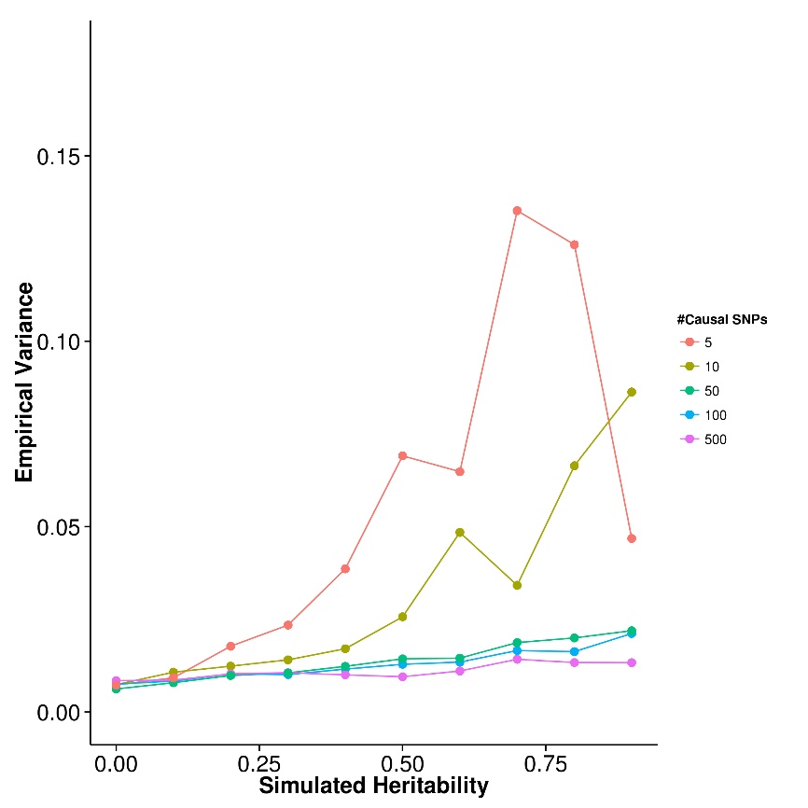
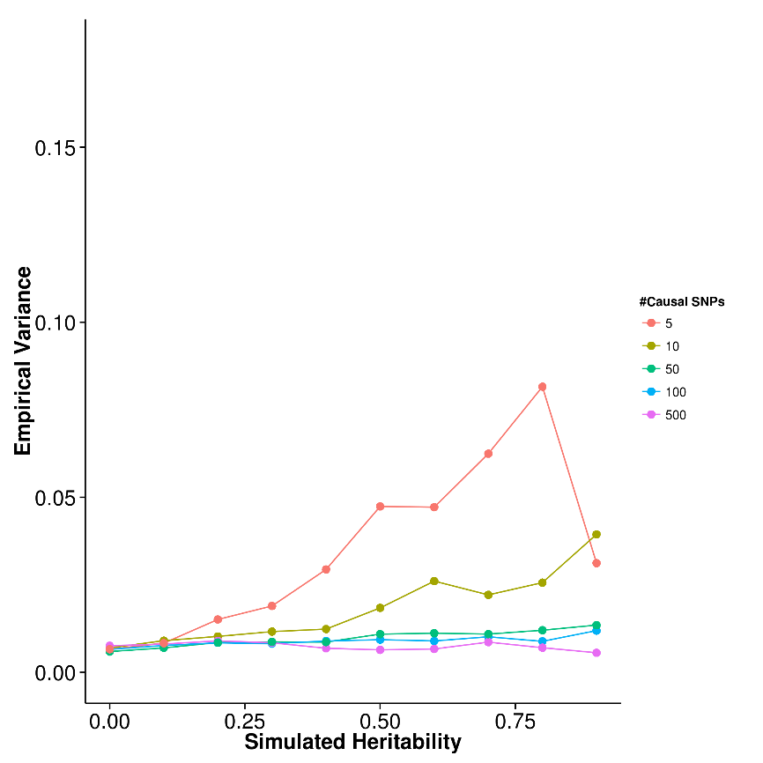
Results (Quantitative Trait)
SHREK
LDSC
GCTA
SHREK has the highest variance
Robust to change in number of causal SNPs
When number of causal SNP is small, variance of LDSC and GCTA increases

Slide 13
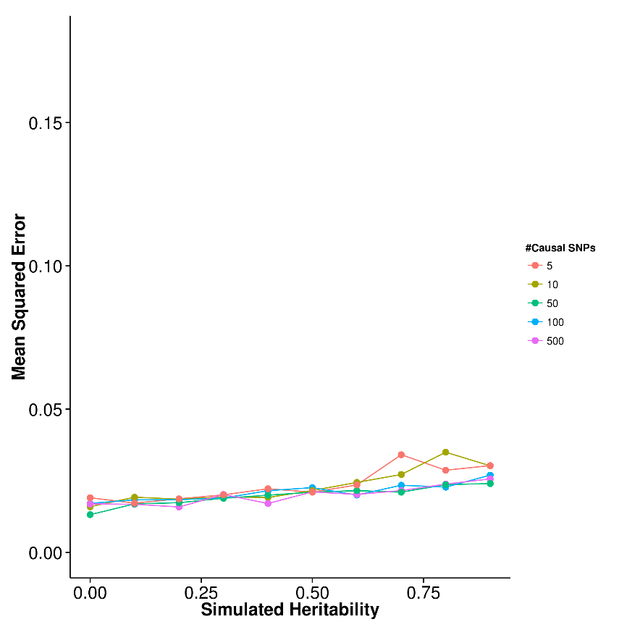
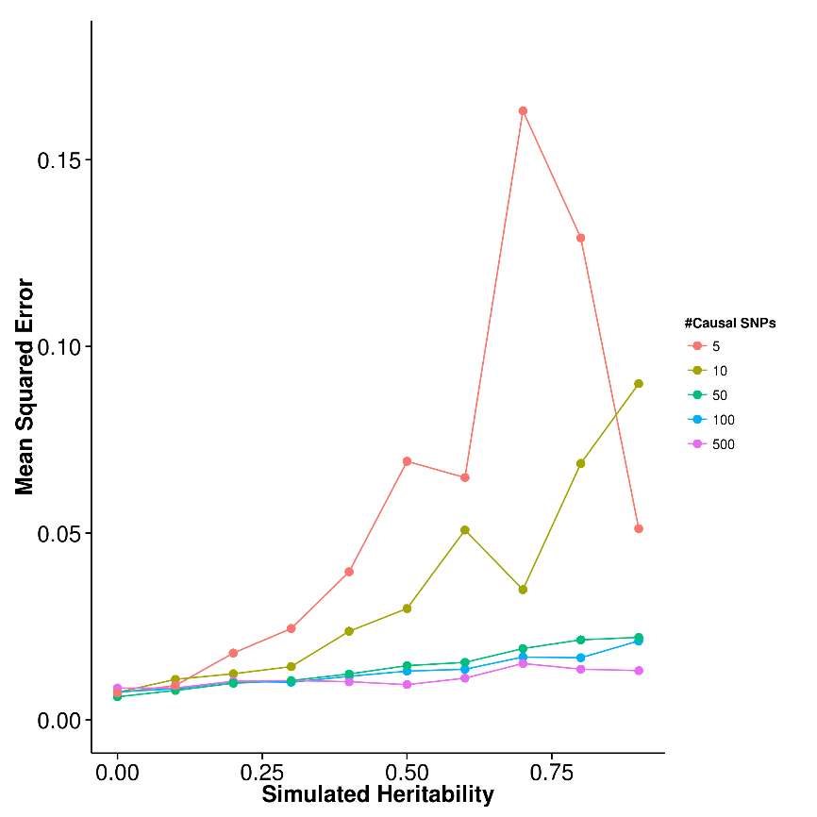
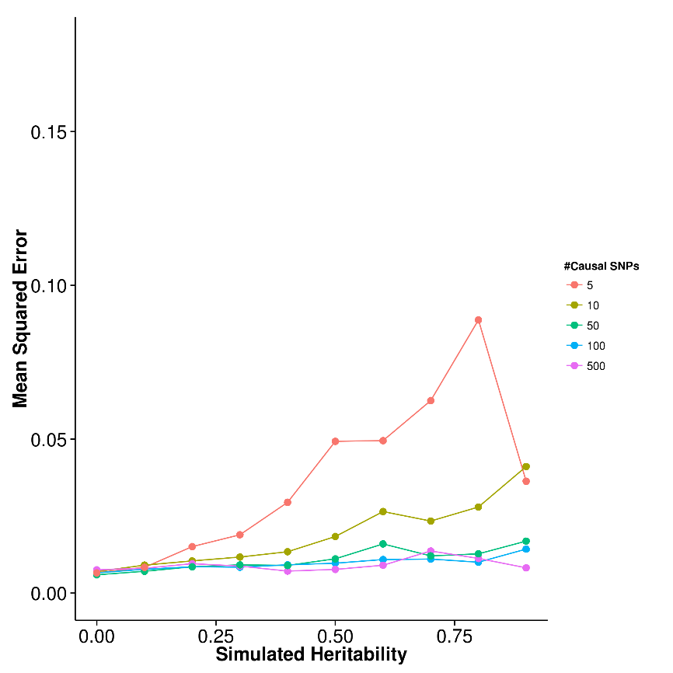
Results (Quantitative Trait)
SHREK
LDSC
GCTA
High mean square error for LDSC and GCTA in oligo-genic condition
SHREK is relatively robust
Notes:
Estimated 500 causal SNP, we need around 10000 samples for LDSC to have the same se as gcta with 1000 samples (given 500 reference)
(GCTA estimated SE ~ 300/N)

Slide 14
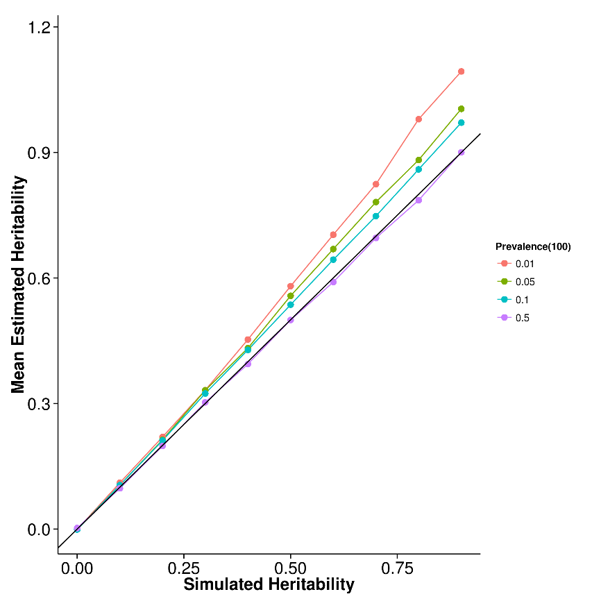
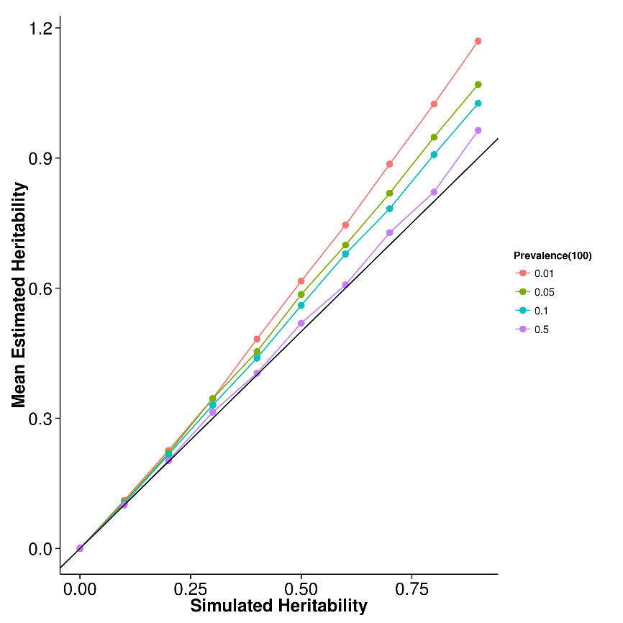
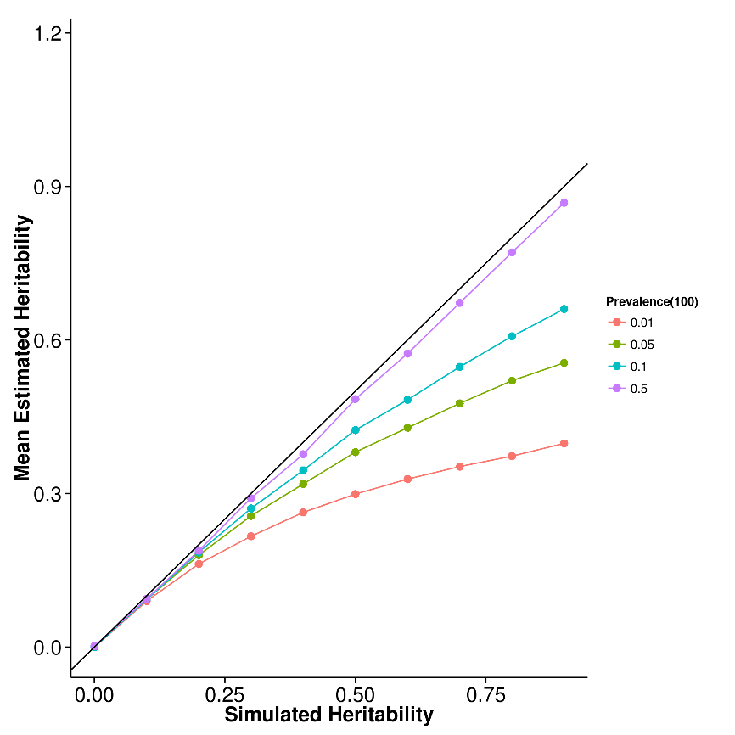
Results (case Control 100 Causal)
SHREK
LDSC
GCTA
Upward bias observed in SHREK and LDSC (proportional to prevalence)
Downward bias observed in GCTA (proportional to prevalence)

Slide 15
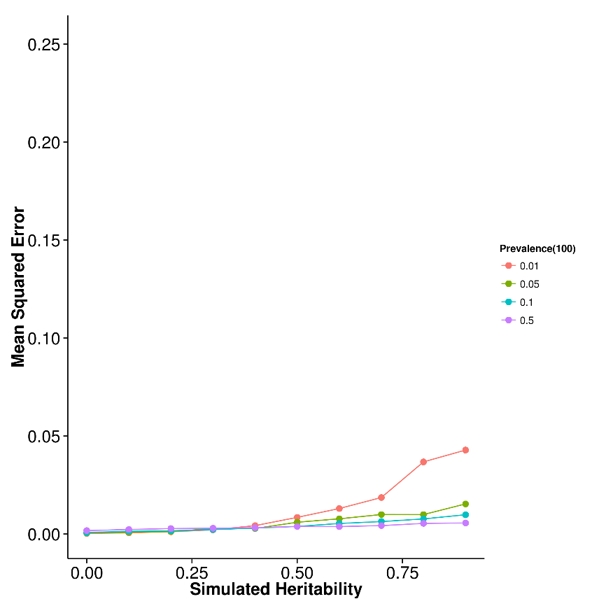
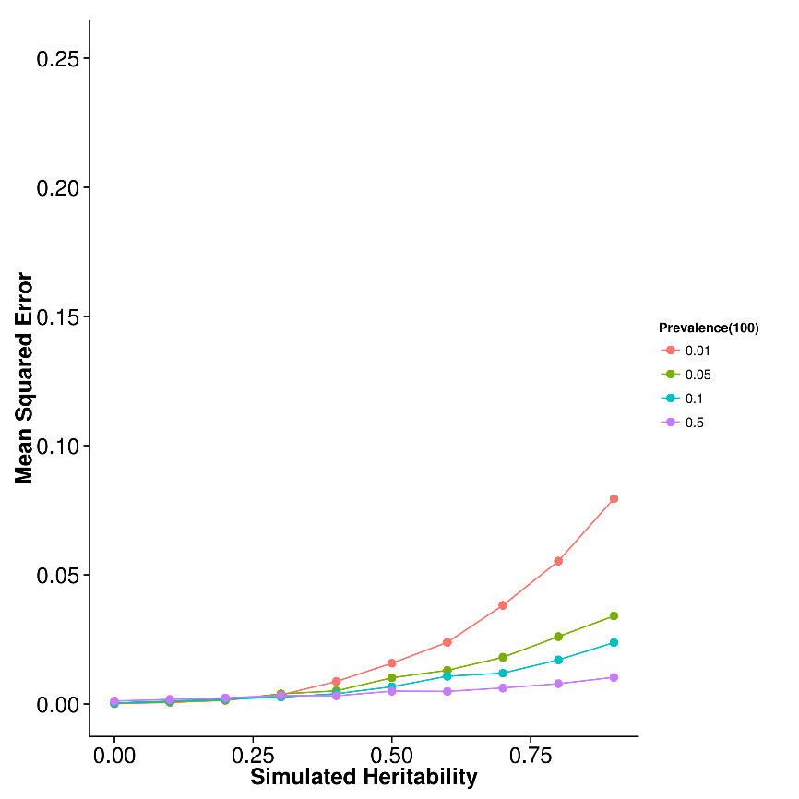
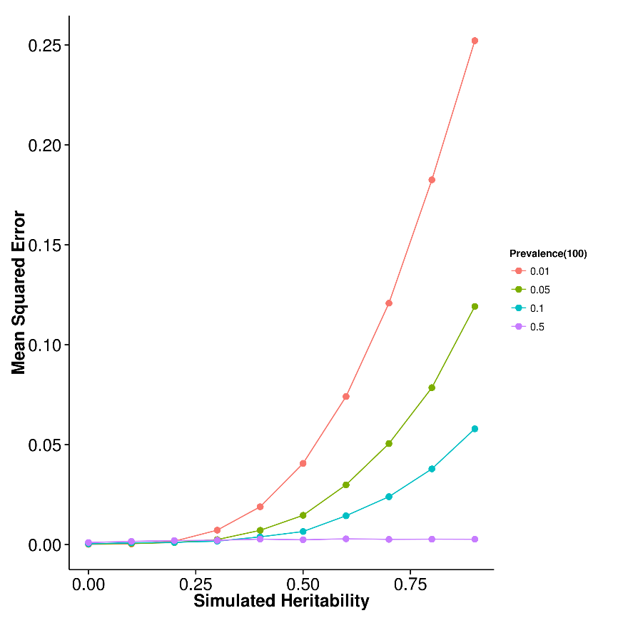
Results (Case Control 100 Causal)
SHREK
LDSC
GCTA
Mean Square error proportional to prevalence
SHREK is most robust

Slide 16
Prevalence |  | Num Causal |  | SHREK |  | LDSC |  | GCTA
0.01 |  | 10 |  | 0.0145 |  | 0.0361 |  | 0.0675
0.01 |  | 50 |  | 0.0135 |  | 0.0254 |  | 0.0702
0.01 |  | 100 |  | 0.0128 |  | 0.0227 |  | 0.0698
0.01 |  | 500 |  | 0.0126 |  | 0.0214 |  | 0.071
0.05 |  | 10 |  | 0.011 |  | 0.0201 |  | 0.0302
0.05 |  | 50 |  | 0.00453 |  | 0.00974 |  | 0.0299
0.05 |  | 100 |  | 0.00569 |  | 0.0113 |  | 0.0304
0.05 |  | 500 |  | 0.0054 |  | 0.00999 |  | 0.0305
0.1 |  | 10 |  | 0.00512 |  | 0.0109 |  | 0.0165
0.1 |  | 50 |  | 0.00381 |  | 0.00824 |  | 0.0152
0.1 |  | 100 |  | 0.00418 |  | 0.00802 |  | 0.0148
0.1 |  | 500 |  | 0.004 |  | 0.0074 |  | 0.0155
0.5 |  | 10 |  | 0.0056 |  | 0.00749 |  | 0.0041
0.5 |  | 50 |  | 0.00362 |  | 0.00528 |  | 0.00244
0.5 |  | 100 |  | 0.00356 |  | 0.0046 |  | 0.00225
0.5 |  | 500 |  | 0.00338 |  | 0.00365 |  | 0.002

Slide 17
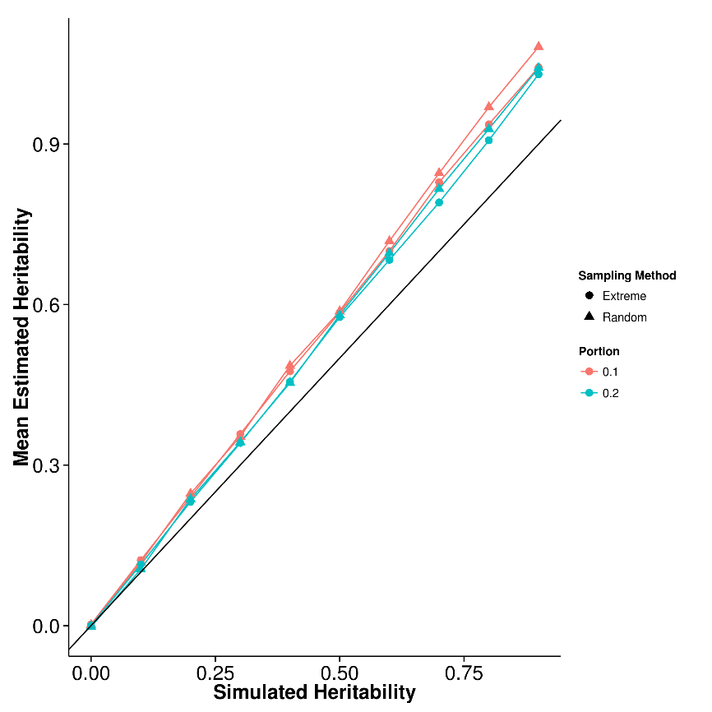
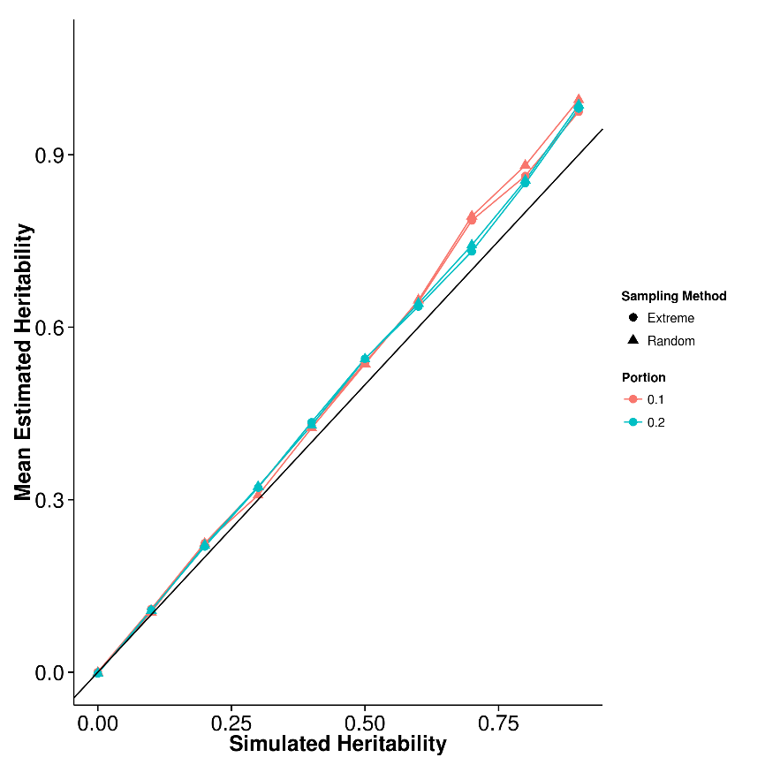
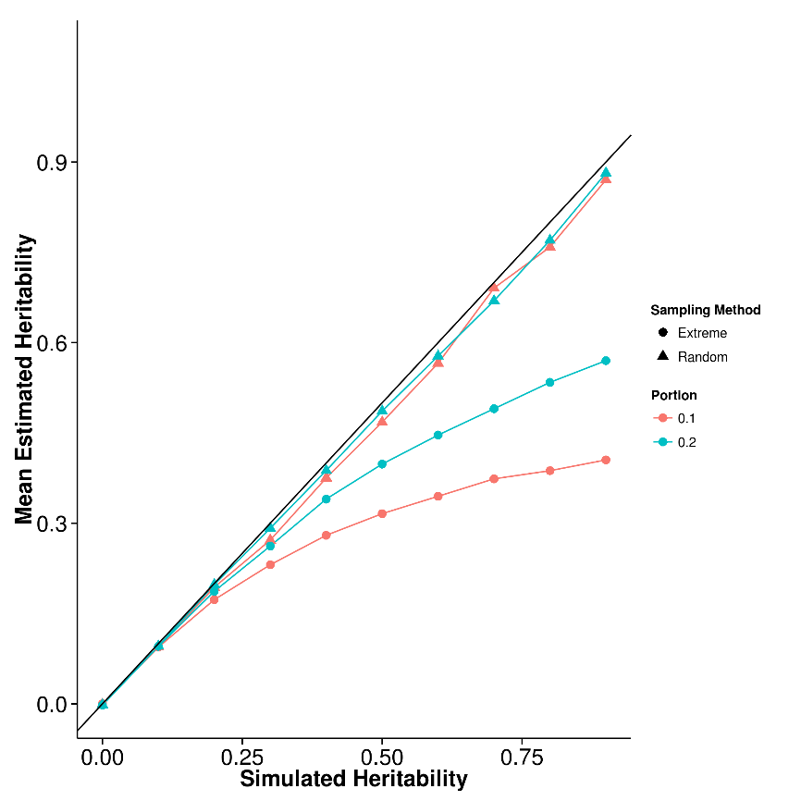
Results (Extreme Phenotype)
SHREK
LDSC
GCTA
Upward bias observed in SHREK and LDSC
Downward bias observed in GCTA when extreme phenotype selection was performed

Slide 18
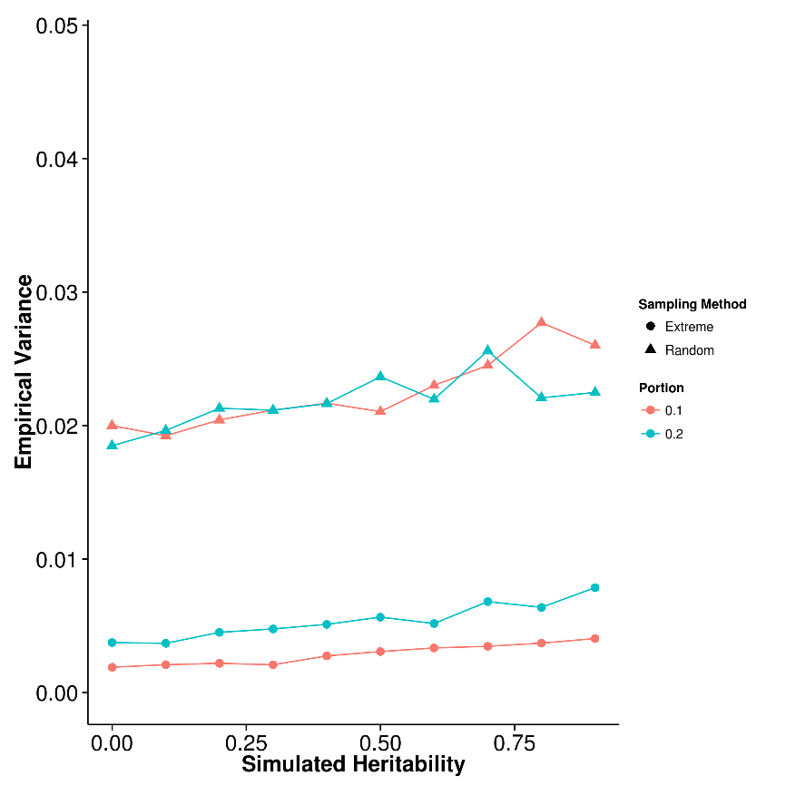
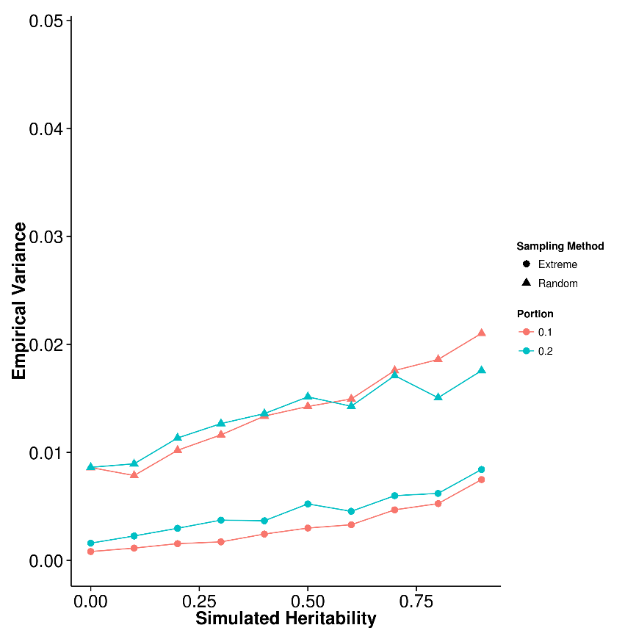
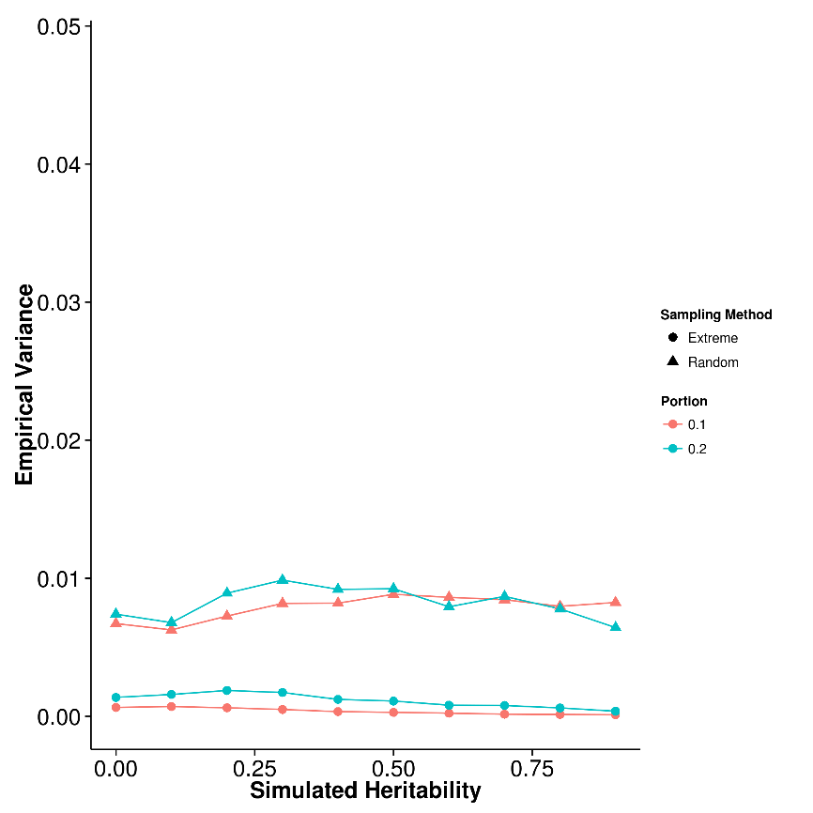
Results (Extreme Phenotype)
SHREK
LDSC
GCTA
Higher variance in random sampling

Slide 19
Result (Real Data)
 | Major Depression Disorder |  |  | Bipolar |  |  | Schizophrenia
 | h² | SE |  | h² | SE |  | h² | SE
SHREK | 0.252 | 0.0273 |  | 0.308 | 0.0167 |  | 0.185 | 0.00450
LDSC | 0.232 | 0.0217 |  | 0.265 | 0.0152 |  | 0.198 | 0.0057
LDSC-In | 0.154 | 0.033 |  | 0.181 | 0.0203 |  | 0.135 | 0.0072

Slide 20
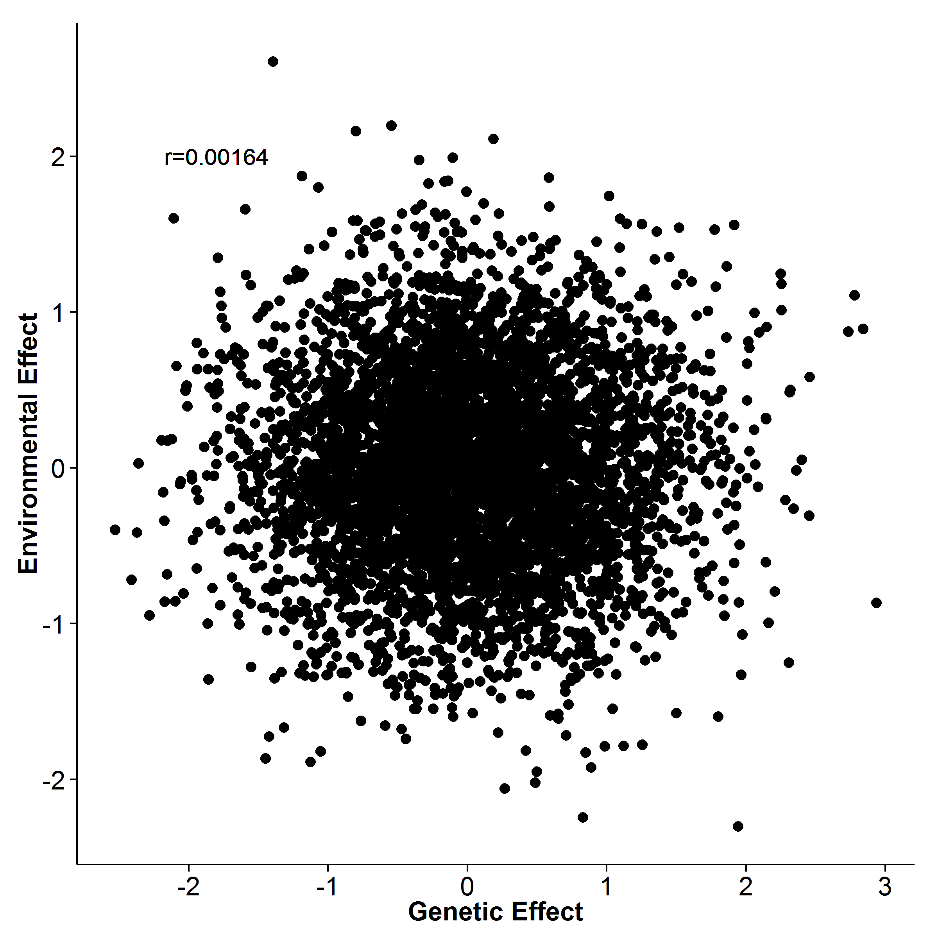
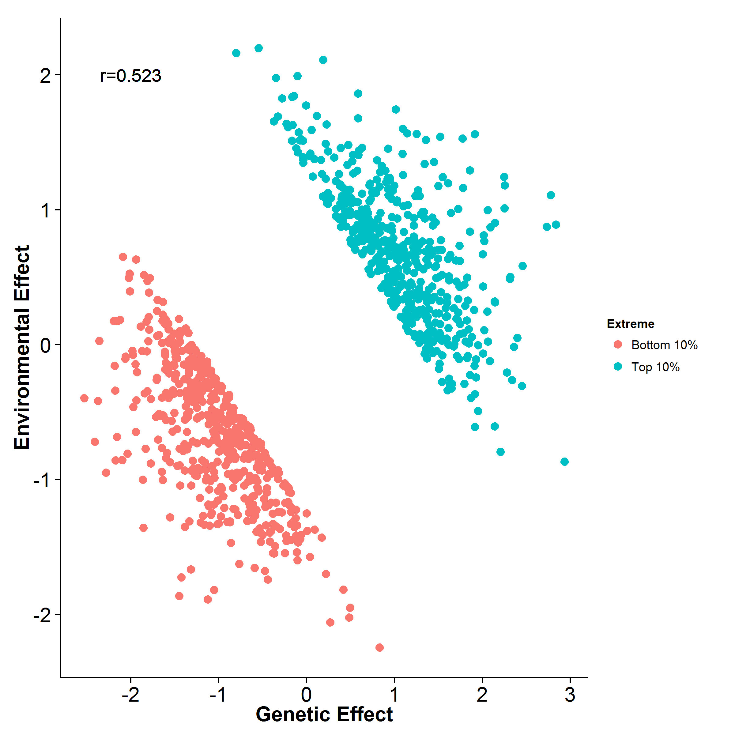
Discussion

Slide 21
Discussion
Common variants in the PGC Schizophrenia GWAS account for at most ∼ 20% of the heritability of Schizophrenia
Possible source of “missing” heritability
Sex chromosome
Rare mutations
Structural variations
Epigenetic changes
Gene-Environmental interaction

Slide 22
Maternal Immune Activation

Slide 23

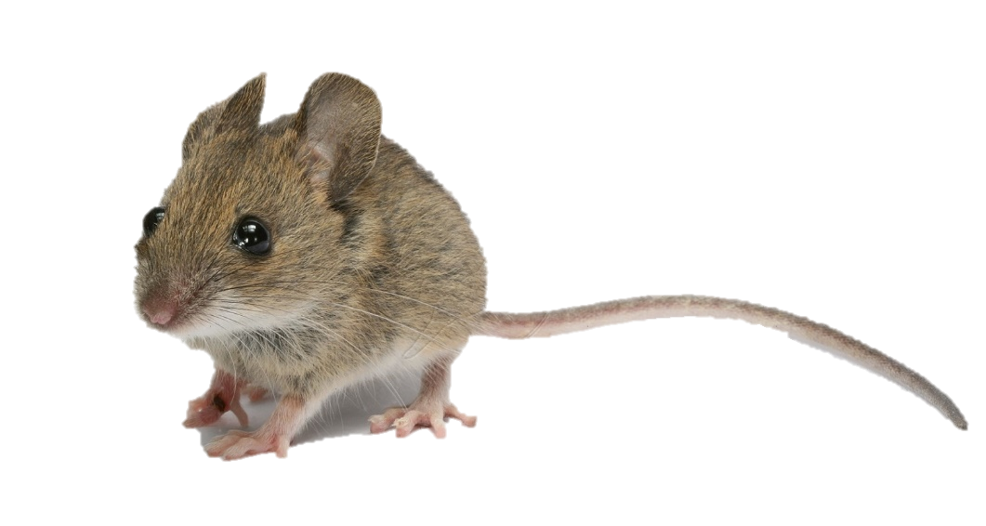
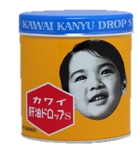
Maternal Immune Activation
Maternal Immune Activation (MIA)
Higher risk of Schizophrenia
Diet (e.g. Omega-3)
Reduce Schizophrenia-like phenotype

Slide 24
sample
Sample ID | Diet | condition | Lane | Batch | RNA Integrity Number (RIN)
3M_2 | Omega 3 | PolyIC | 1 | B | 7.7
6M_2 | Omega 3 | PolyIC | 2 | B | 7.7
4M_3 | Omega 3 | PolyIC | 1 | F | 7.6
1M_2 | Omega 3 | Saline | 2 | F | 8.1
5M_2 | Omega 3 | Saline | 1 | B | 7.8
14M_3 | Omega 3 | Saline | 2 | B | 7.7
2M_2 | Omega 6 | PolyIC | 1 | F | 7.5
11M_4 | Omega 6 | PolyIC | 2 | E | 7.8
7M_1 | Omega 6 | PolyIC | 2 | C | 7.9
13M_2 | Omega 6 | Saline | 2 | B | 7.4
14M_5 | Omega 6 | Saline | 1 | E | 8.0
1M_3 | Omega 6 | Saline | 1 | C | 7.8

Slide 25
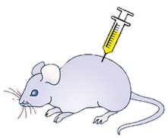
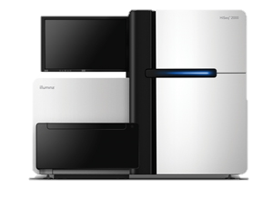
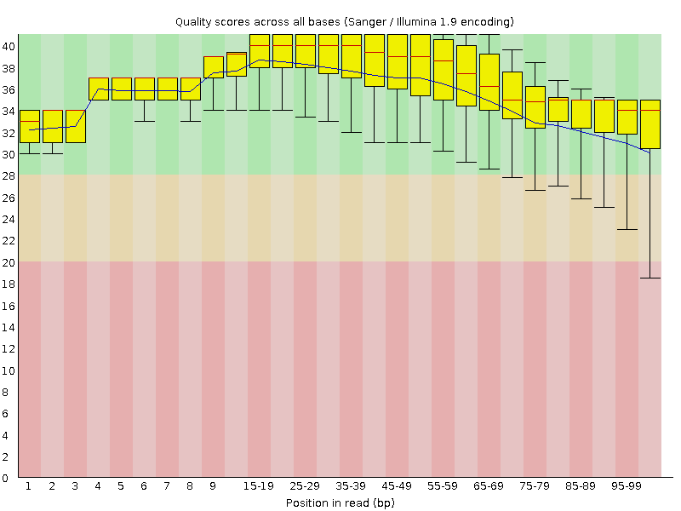
Methodology
birth
Injection of PolyIC / Saline on GD9.5
Different Diet
Extraction of RNA & Library Construction
Expression Count
(HTSeq)
Alignment
(STAR)
Quality Control
RNA
Sequencing
Down-stream analysis
Differential Gene Expression
Candidate
Gene Set Enrichment

Slide 26
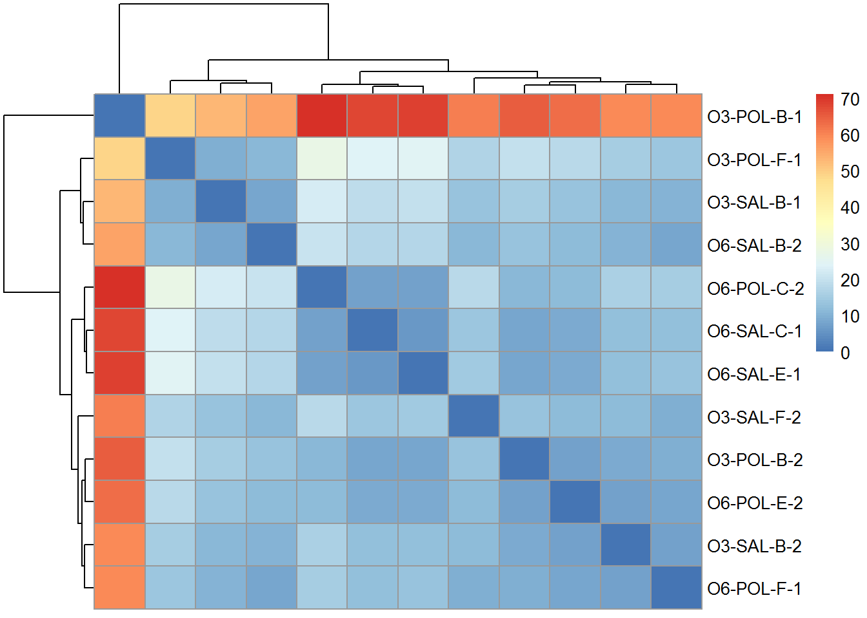
Quality Control

Slide 27
Statistic Model
~Batch+condition+Diet+condition:Diet
Wald Test (DESeq2)
Sample ID | Diet | condition | Batch
6M_2 | Omega 3 | PolyIC | B
4M_3 | Omega 3 | PolyIC | F
1M_2 | Omega 3 | Saline | F
5M_2 | Omega 3 | Saline | B
14M_3 | Omega 3 | Saline | B
2M_2 | Omega 6 | PolyIC | F
11M_4 | Omega 6 | PolyIC | E
7M_1 | Omega 6 | PolyIC | C
13M_2 | Omega 6 | Saline | B
14M_5 | Omega 6 | Saline | E
1M_3 | Omega 6 | Saline | C

Slide 28
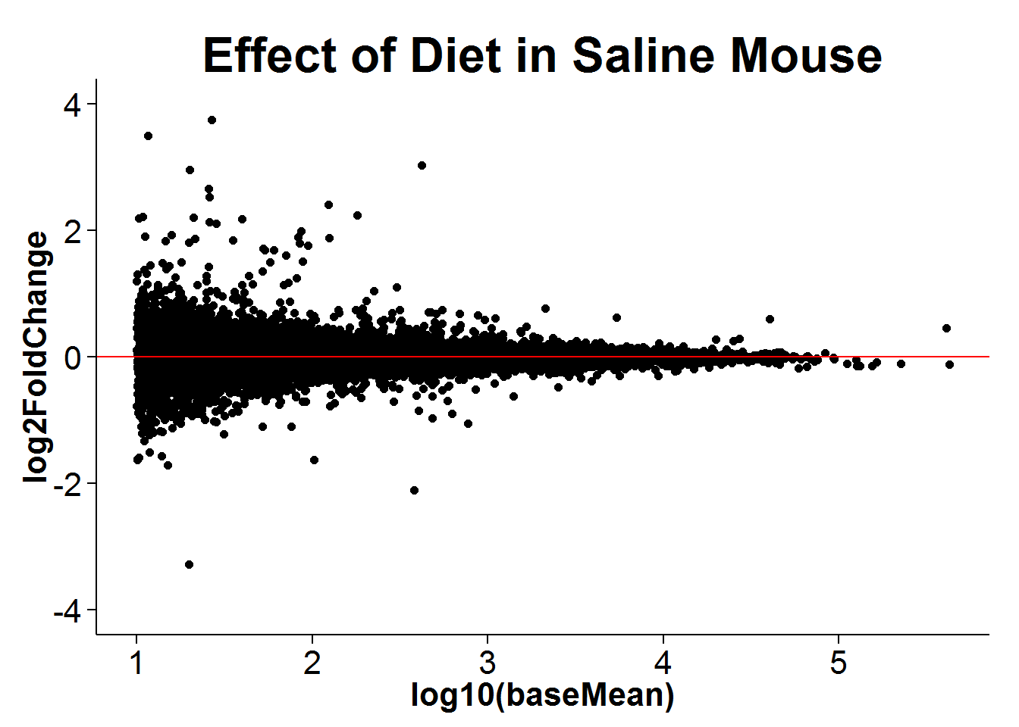
Results
Effect of Omega 3 in Saline injected samples

Slide 29
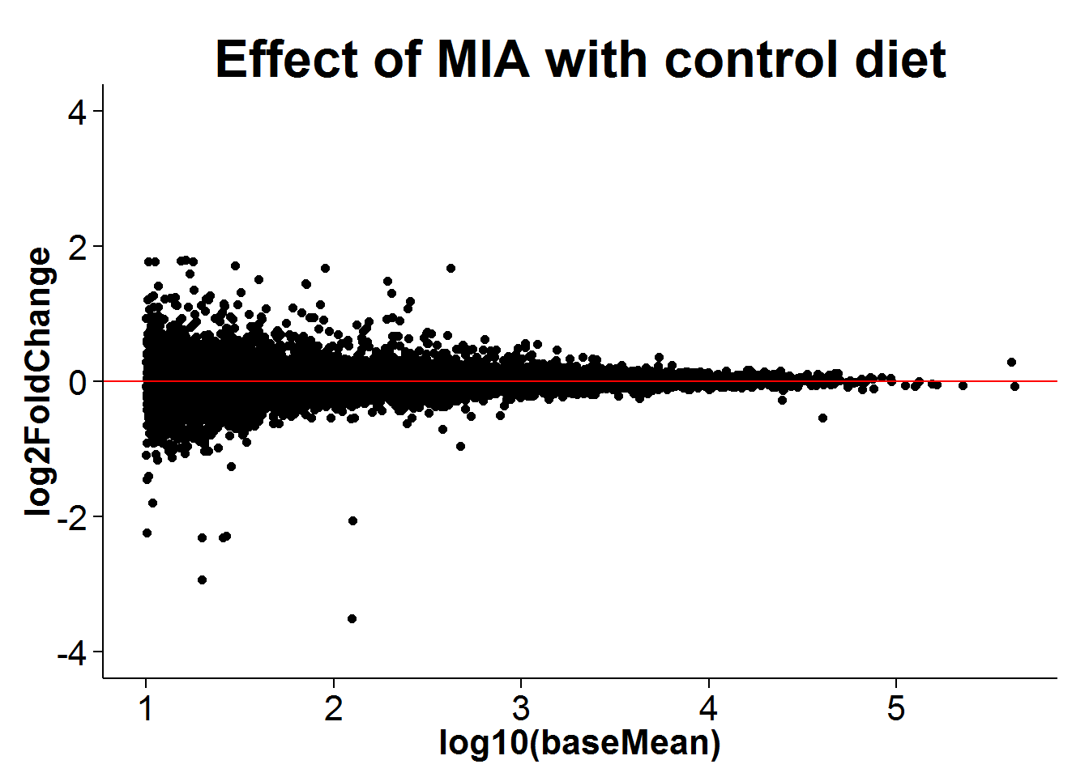
Results
Saline injected vs PolyIC injected (with control diet e.g. Omega 6)

Slide 30
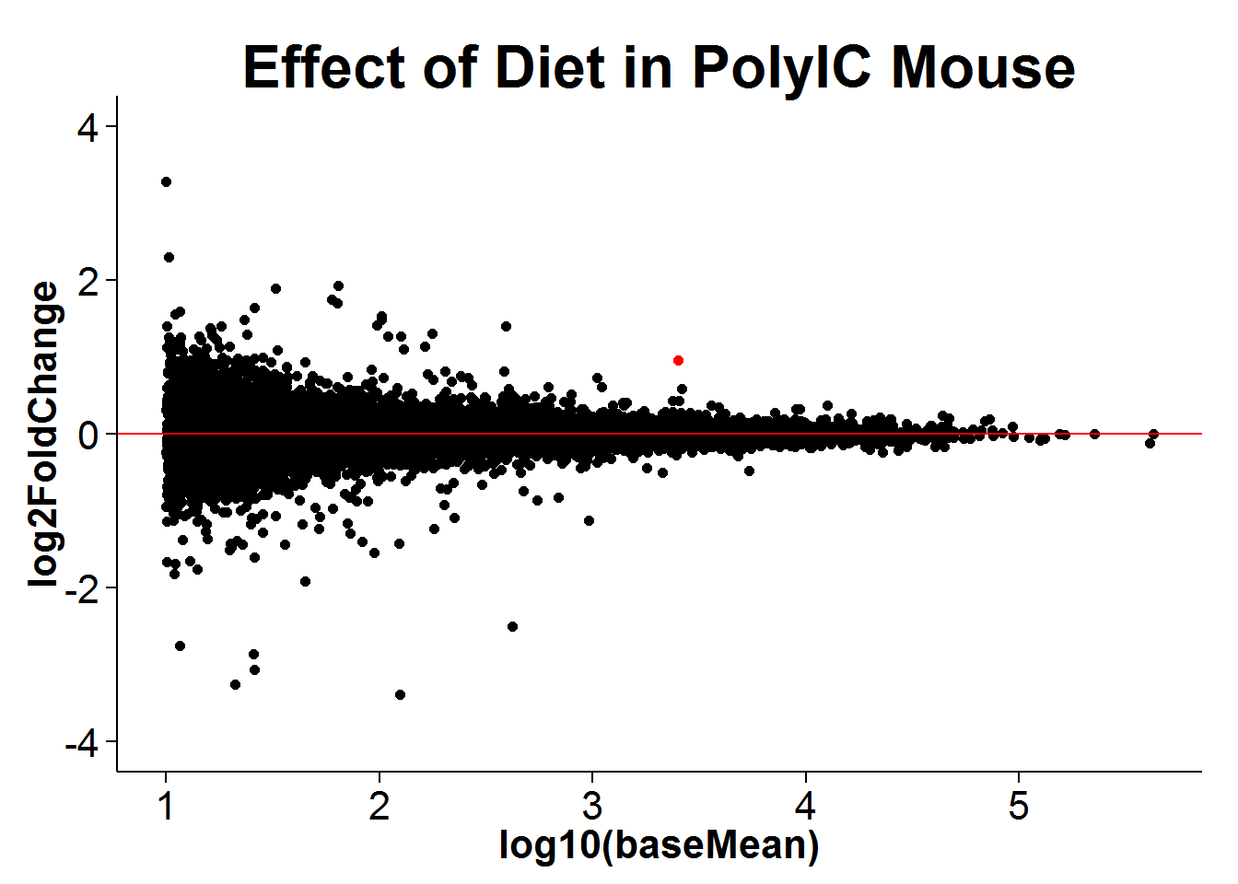
Results
Effect of Omega 3 in PolyIC injected samples
Sgk1

Slide 31
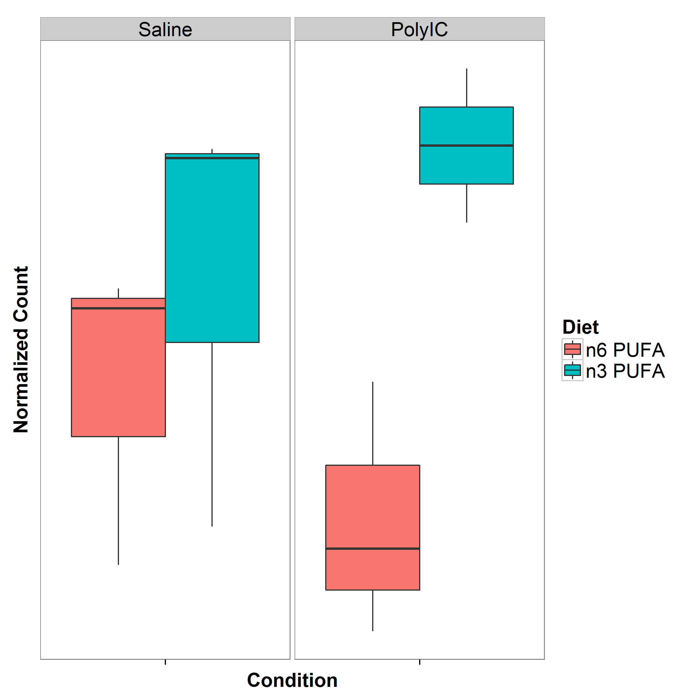
Expression of sgk1

Slide 32
Function of Sgk1
Associated with (in rat)
spatial learning
fear-conditioning learning
recognition learning
4 fold increase in hippocampus of fast learners when compared to slow learners
Regulates the AMPA and kainate glutamate receptors, especially GluR6
Up-regulates the glutamate transporters
Potentially prevents the neurotoxic effects of glutamate

Slide 33
Gene Set analysis
Candidate Gene sets from
The Network and Pathway Analysis Subgroup of the Psychiatric Genomics (2015). Nat Neurosci
Purcell, S M et al. (2014). Nature
Wilcoxon Rank Sum Test
Non-parametric
Competitive

Slide 34
Gene set
Gene Set | Source | Size | Category | Diet in PolyIC (p-value) | Diet in Saline (p-value) | MIA (p-value)
Calcium Ion Signaling Pathway | KEGG | 180 | Calcium Ion | 0.0402 | 0.231 | 4.40x10⁻⁷
Glutamatergic Synapse | KEGG | 114 | PSD | 0.118 | 0.123 | 0.00490
Voltage-Gated Calcium Channel Activity | GO | 44 | Calcium Ion | 0.0262 | 0.137 | 3.45x10⁻⁶
Calcium Channel Activity | GO | 111 | Calcium Ion | 0.0942 | 0.0880 | 0.00209
Post Synaptic Density | GO | 194 | PSD | 4.86x10⁻³ | 0.0383 | 6.31x10⁻⁹
Post Synaptic Density | Purcell et al | 685 | PSD | 0.113 | 0.977 | 0.328
Schizophrenia GWAS | Purcell et al | 479 | GWAS | 0.3048 | 0.551 | 6.91x10⁻³
Notes:
all calcium ion channel gene sets accounts for around 0.77-1.35%
PSD gene sets contribute 1.34% to 4.86%
GWAS gene set contribute 9.9% of the SNP heritability.
Focus on the overlap of evidence e.g. converging evidence of functional gene sets. Gene sets with burden of common variant in Schizophrenia also implicated in MIA condition

Slide 35
Discussion
Omega-3 rich diet might indirectly enhance the expression of Sgk1 in PolyIC exposed mice
Leading to reduction of Schizophrenia-like behaviors
Functional gene sets associated with Schizophrenia also affected by MIA
Converging evidence
Small sample size
Insufficient power
Larger sample size is required for validation

Slide 36
Conclusion

Slide 37
Conclusion
Developed SHREK
Outperform LDSC in oligo-genic traits
Common Variants contribute <20% of the heritability of Schizophrenia
Other genetic factor might involve (e.g. CNV, rare variants)
Possible GxE interaction
Maternal Immune Activation
Potentially affect gene sets that are enriched with variants associated with Schizophrenia
Calcium Ion Signalling and Post-Synaptic Density might be important in the etiology of Schizophrenia

Slide 38
END

Slide 39
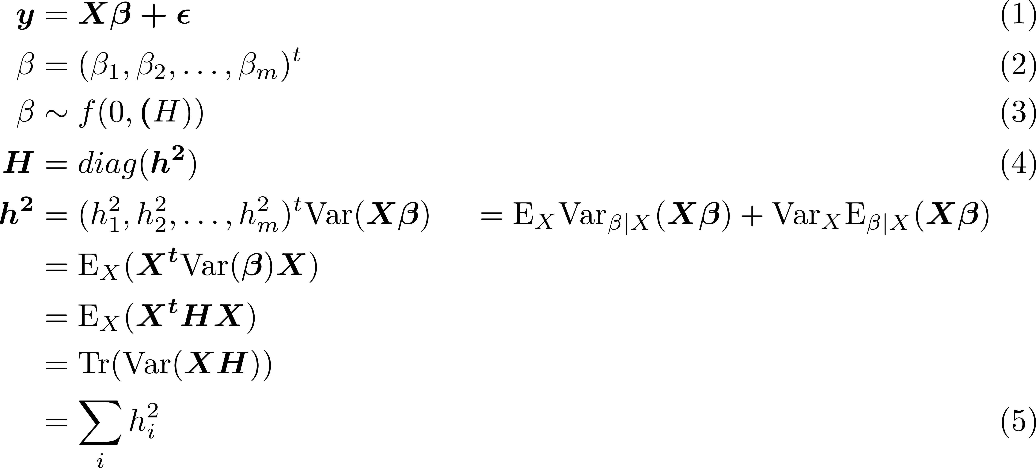
Proves
Notes:
Here we should write down the full mathematically prove of SHREK

Slide 40
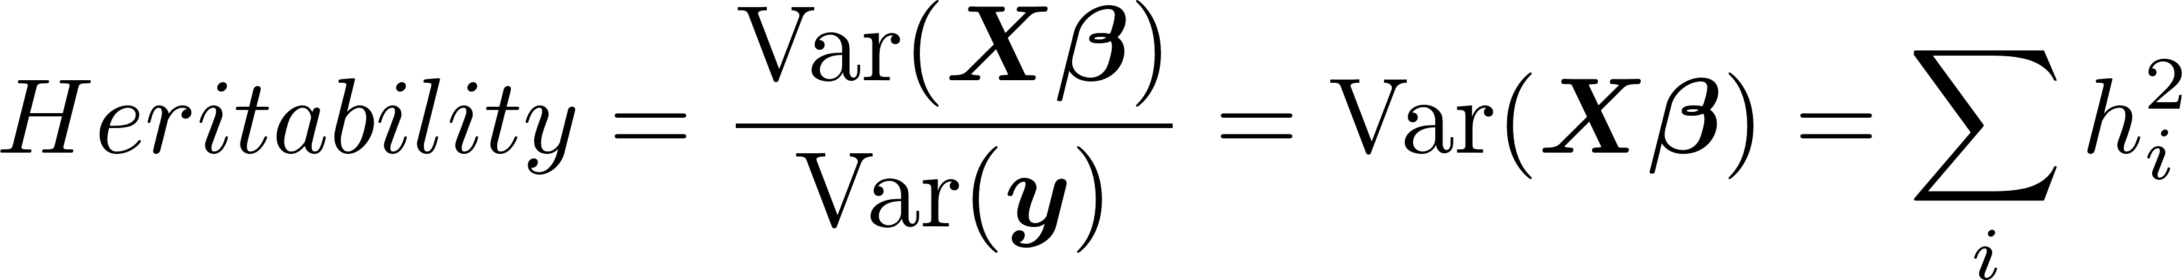
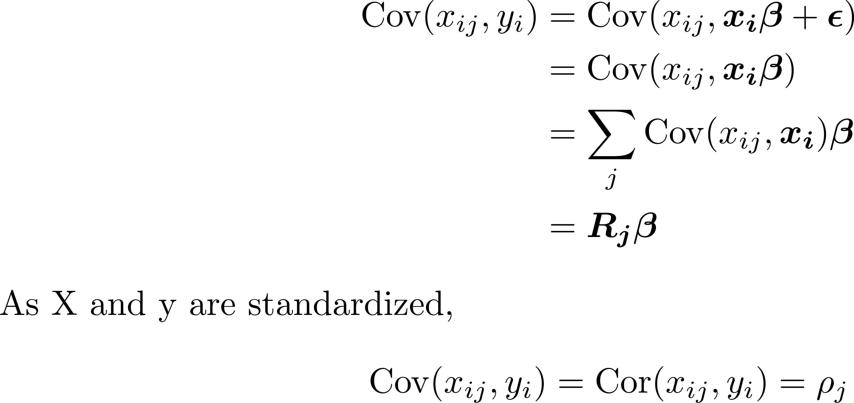
Proves

Slide 41
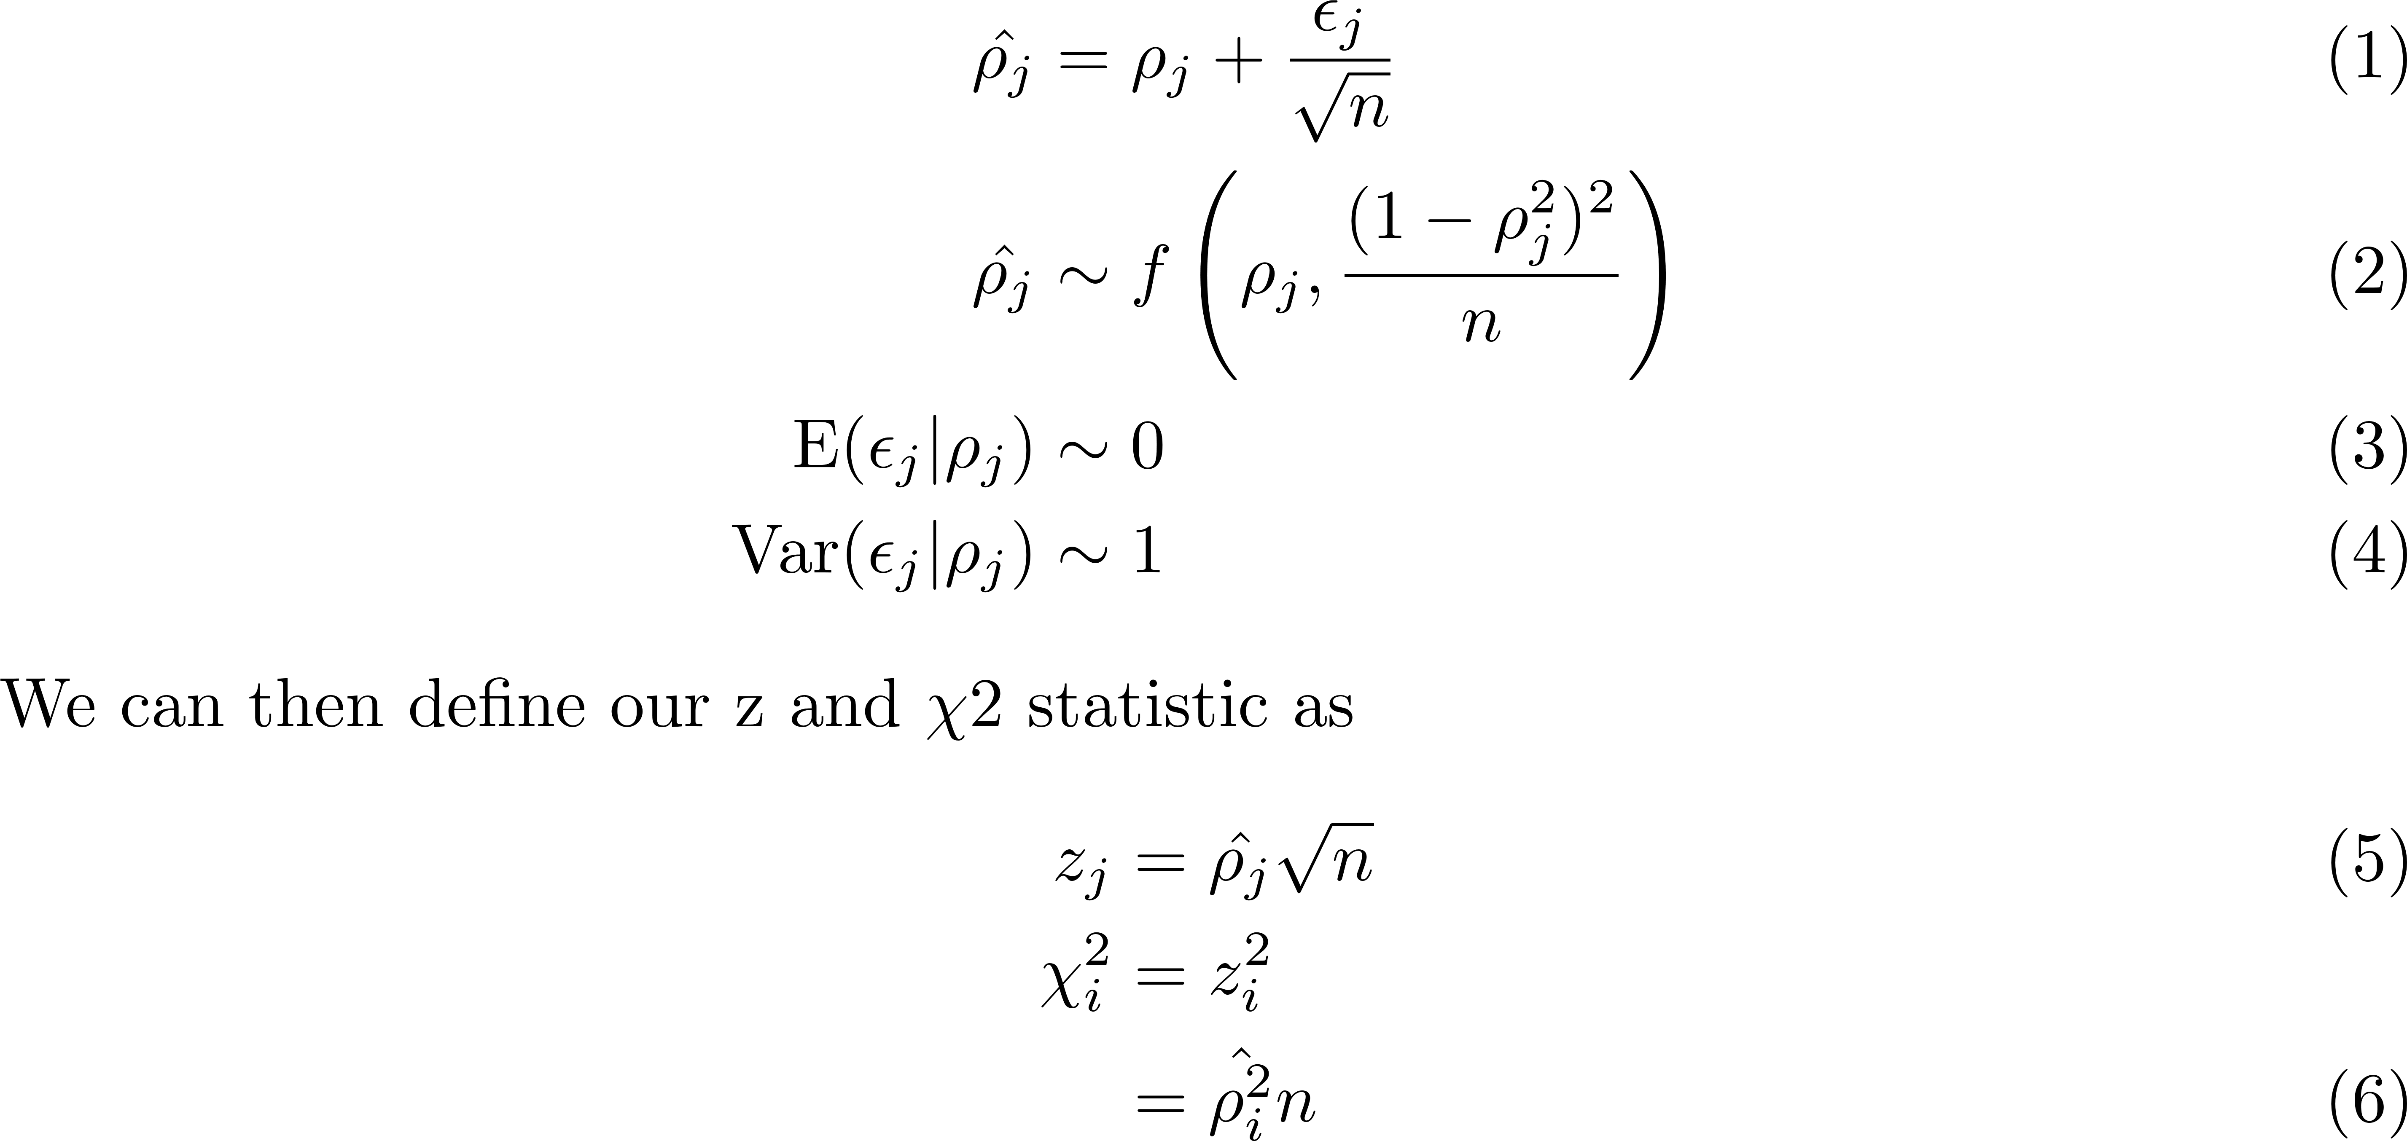
Proves

Slide 42
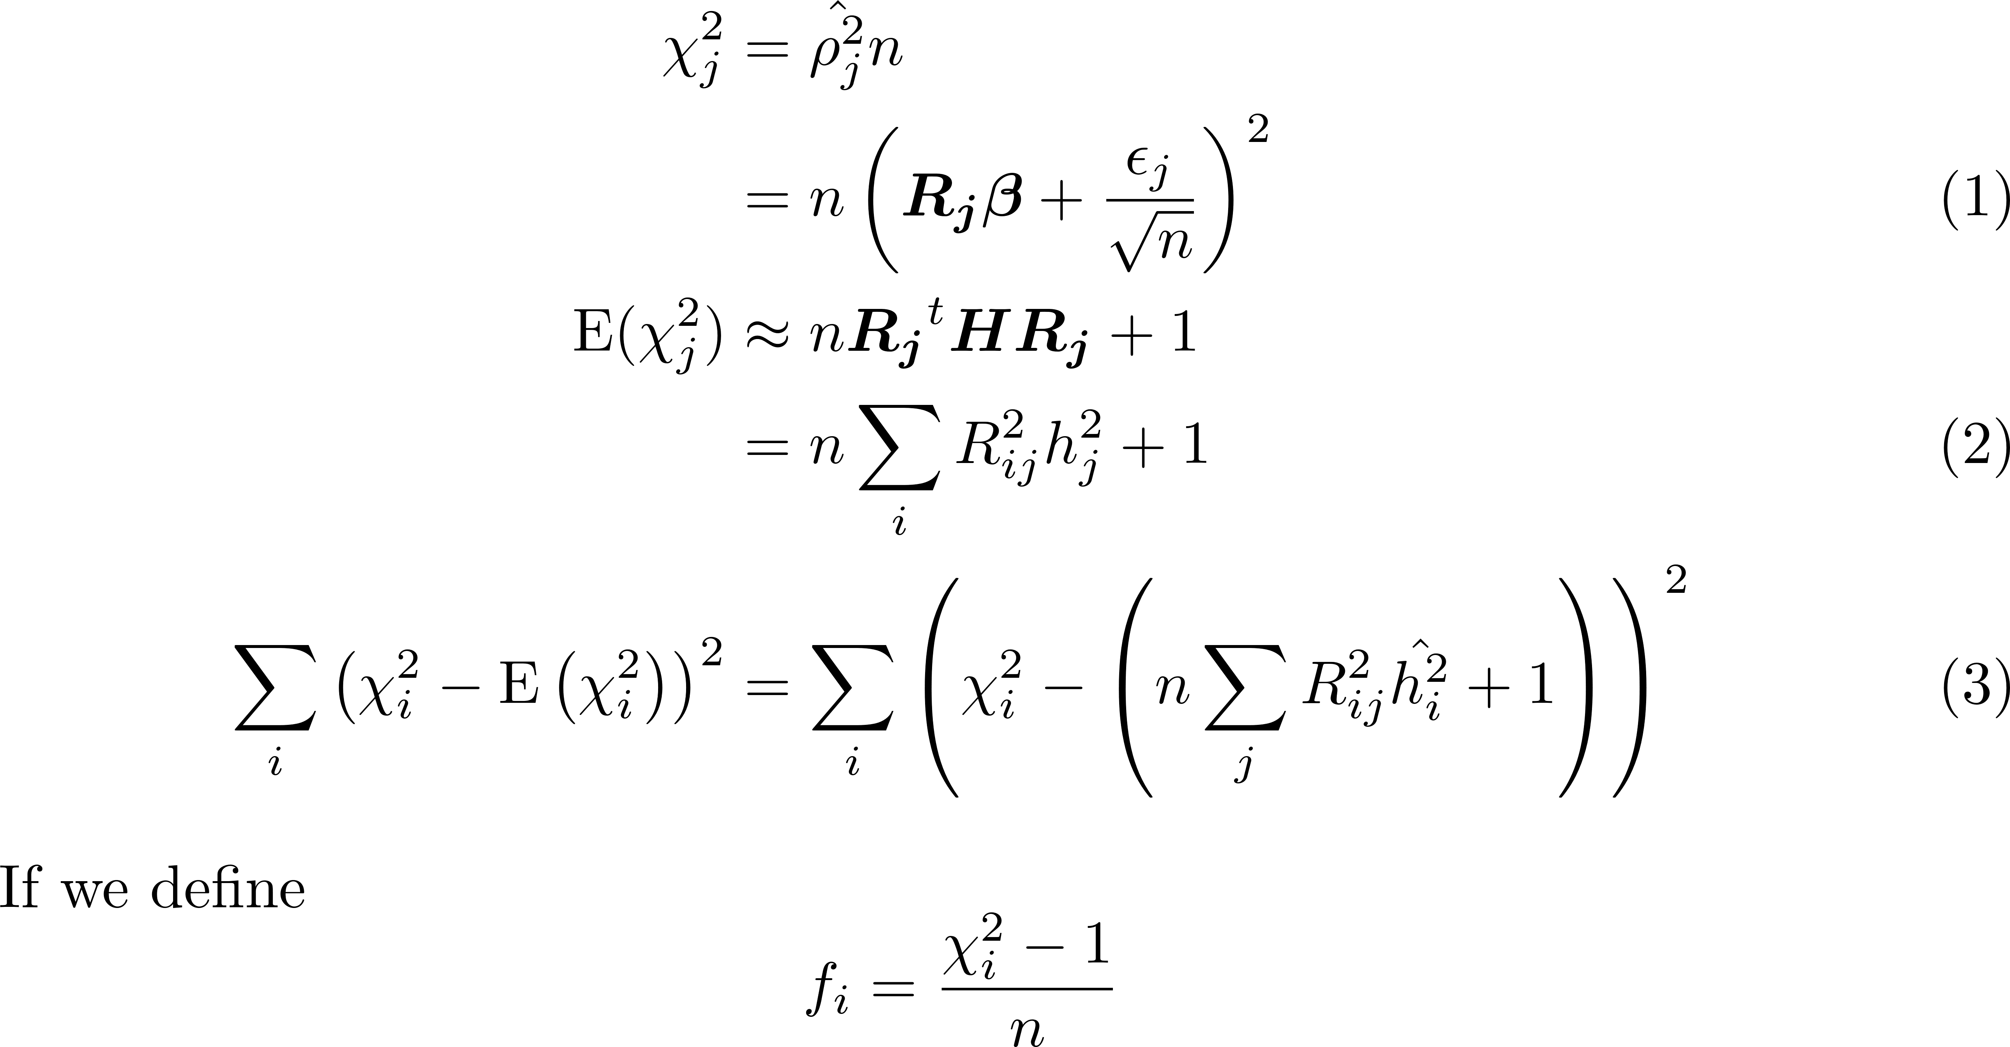
Proves

Slide 43
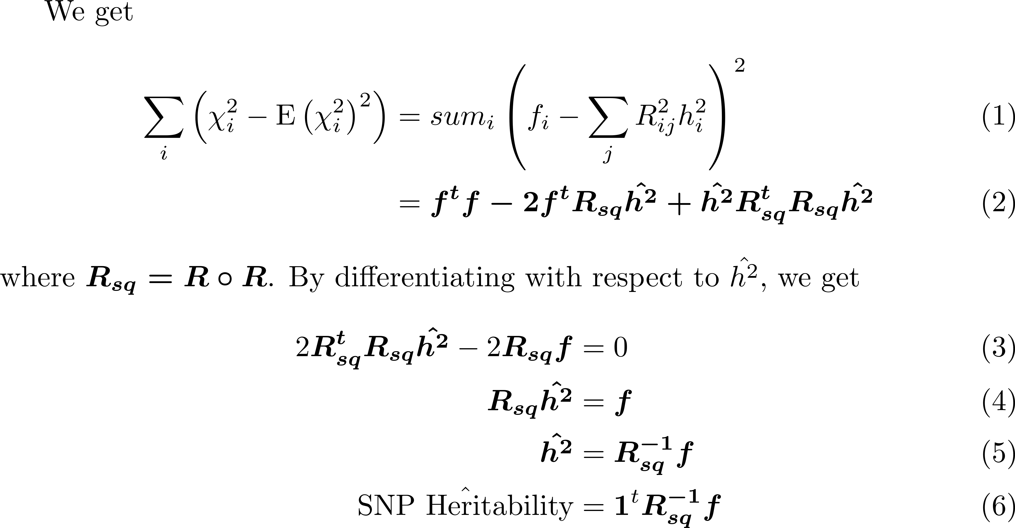
Prove

Slide 44
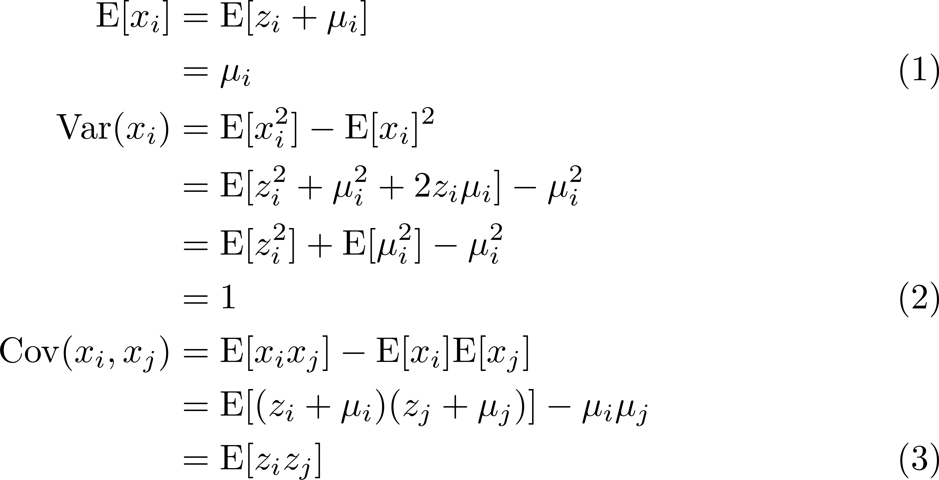
Standard Error

Slide 45
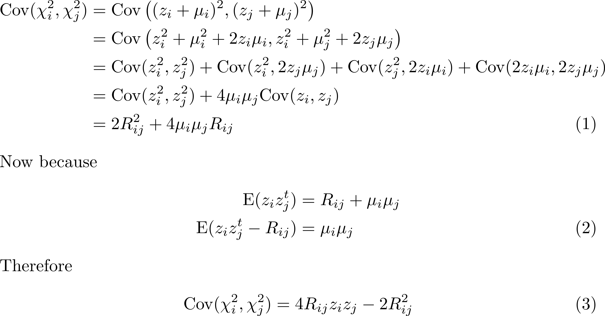
Standard Error

Slide 46
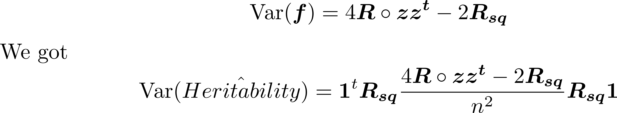
Standard Error
The variance covariance matrix is therefore

Slide 47
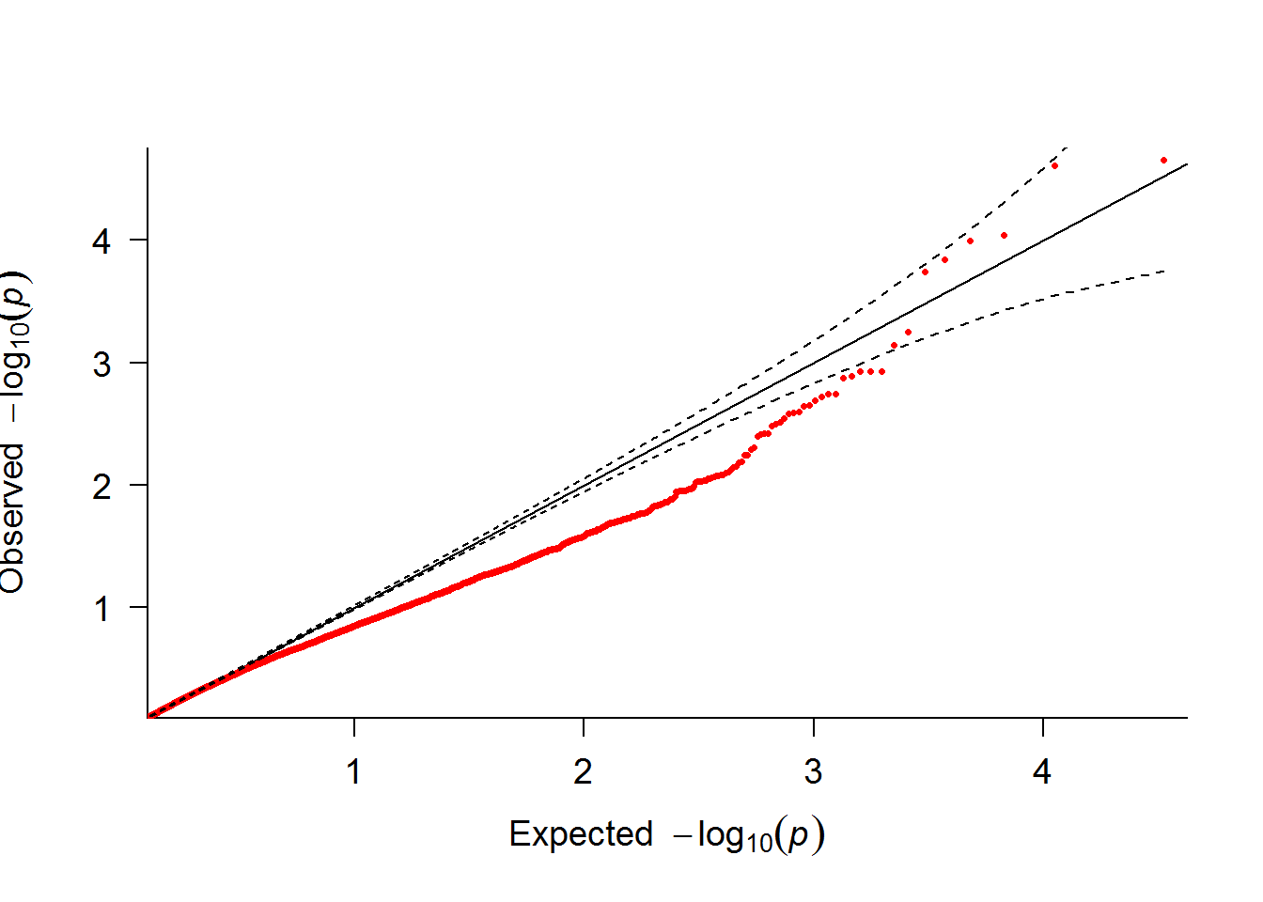
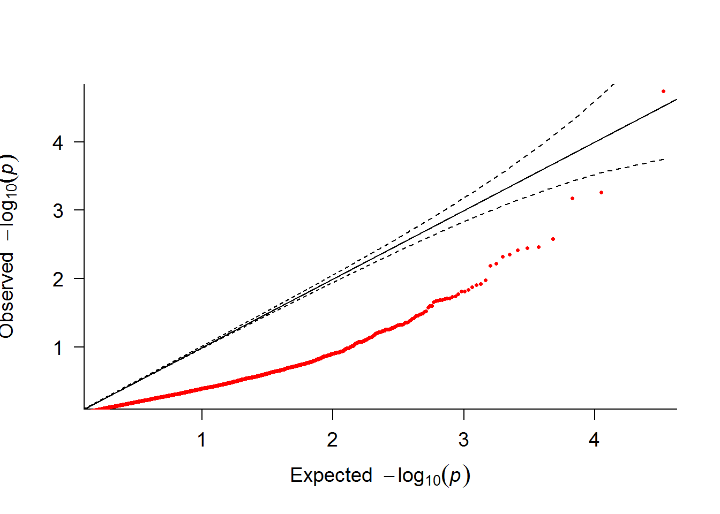
Compare QQ
Effect of Omega 3 in Saline injected samples
Without batch
With batch

Slide 48


Compare QQ
Saline injected vs PolyIC injected (with control diet e.g. Omega 6)
Without batch
With batch

Slide 49


Compare QQ
Effect of Omega 3 in PolyIC injected samples
Without batch
With batch

Slide 52


Methodology
We can express the association as
y = vector of standardized phenotype
X = standardized genotype matrix
$ε$ = error term
β = regression coefficient
Notes:
In order to estimate the SNP heritability using only the summary statistics, we need to first understand the association analysis.
In a common GWAS, we can often perform the association in form of Y=XB+Error term. If we standardize the phenotype and genotypes,

Slide 53



Methodology
If we assume that follows the distribution
H represents the variances of the “true” effects
Most importantly, heritability can then be expressed as
Notes:
Now, if we assume beta follow a distribution with mean of 0 and variance of H where H is a diagonal matrix of h^2, we can represent the variance of X beta as the sum of h^2

Slide 54



Methodology
If we consider covariance between SNP_{j} ($x_{j}$) and phenotype of i^{th} individual ($y_{i}$),
Where is the row vector of correlations of SNP j with all other SNPs
Because x and y are both standardized, we have
Notes:
Now if we consider the equation of heritability which is the variance of genetic factors over variance of phenotype, we can see that the SNP heritability is represented as variance of X beta, which in term can be represented as the sum of h^2
If we then consider the covariance between SNP j and the sample phenotype, it was observed that the correlation between a particular SNP and the phenotype can be represented as LD times beta

Slide 55




Methodology
Now if we consider the error in the observed correlation, we have (define n)
Now if we define our $χ^{2}$ test statistic as , we can get
Notes:
Now in reality, the observed correlation might contain sampling errors. By taking into consideration of the sampling errors, we can represent the expectation of the Chi Squared test statistics in terms of the LD matrix and the sum of h^2

Slide 56







Methodology
We then want to calculate the least square estimates of
By differentiating with respect to the vector of , , we get
Where and . As a result of that, we can get
Notes:
By performing the least square estimates of h^2, we can obtain the ff something equation where f equals to the chi square minus 1 divided by the number of samples n.
By differentiating the equation, we can get R square times h^2 equals to f
Therefore, we can estimate the SNP heritability as the sum of the inverse of R square times F

Slide 57



Methodology – Problem of Collinearity
Notes:
In an ideal situation, we can easily calculate the equation. However, reality is cruel. The LD matrix are usually ill conditioned.
To understand what is meant by ill conditioned, we can consider that in a simple situation with two predictors X1 and X2 and the dependent variable Y, the X1 and X2 will form a plane, plane X.
The predicted variable Y’ is obtained by projecting Y orthogonally onto plane X.
When two predictors are only mildly correlated, the plane X is well formed
However, when both predictors are completely collinear, then it is basically equal to regression with one predictor
The real problem is when two predictors are highly correlated. Then although a plane X is defined, a small change in either of the predictors can change the results drastically. For example if X1 drops slightly below the original plane X, then the new plane can turn drastically, and the results will differ

Slide 58



Methodology – Calculating the Inverse
Singular Value Decomposition (SVD) of a Matrix can be represented as
The inverse of the matrix is therefore
Truncated SVD
Notes:
Where U and V are the orthogonal matrix and Sigma is a diagonal matrix of singular values
By replacing small singular values by zero, we reduces the condition number of the matrix, therefore allow us to obtain an approximation to the inverse

